Slide 1



Welcome to willow & beech
MRS TAHANCI – Willow
T.A.: MRs Cooper
Mrs REHAN
Mrs Langley – Beech
T.A.: Mrs Khan,
Ms Baines
Mrs Pervaz

Slide 2


Attendance
School starts promptly at 08:50 and finishes at 15:15
Children need to be collected at 15:15 as all gates locked at 15:25
Please phone school if your child is ill or absent for any other reason or send a Dojo to Ms Coxe or your class teacher
Holidays must be taken during school holidays and no permission will be granted for holidays during term-time
Prizes and trips will be provided for best class and 100% attendance children

Slide 3

Collection arrangements
If you would like your child to be collected by another person at the end of the school day, then please contact the school to let us know of these changes.
Your child’s safety is of primary importance and therefore children will not be allowed to go home with someone that we are not aware of.

Slide 4
Class Information
Playground – breaks 10:20 – 10:35
Toilets straight after break and after dinner
Personal equipment – No need!
Golden Time
Lunchtime: 12:15 – 13:00
Healthy snacks can be brought in for break time
Class Dojo

Slide 5
Uniform
Children must wear the appropriate school uniform – no hoodies, caps, full black trainers may be worn without excessive branding etc.
PE kit is part of school uniform and should be worn to school on the day of your child’s PE lesson. Remember to bring a coat!
P.E. Days:
Beech Class Thursday and Friday
Willow Class – Friday

Slide 6
Essential equipment for school
Warm, waterproof coat
reusable water bottles
labelled
Named lunchbox
Reading Diary and reading book
Labelled inhaler (if needed)

Slide 7
Reading Diaries / books
Your child will shortly be issued with a reading book which is pitched to their reading level.
Please listen to your child read as much as possible and sign their reading diary when they have read.
We recommend a little reading every night.
Any adult or older sibling may sign the planner.
Books changed once a week

Slide 8
Homework
Homework and reading books will be issued on Thursday
Returned no later than Wednesday of the following week.
If it is handed in late, they may not be changed.
Your child will be given Spellings and Times Tables homework each week.
Times Tables tests will be administered on Thursday or Fridays with set tables this term. After Christmas, they will be mixed tables, in preparation for national tests

Slide 9
Help at home
You may help at home by quizzing your child regularly on their weekly spellings. Short burst spelling practice everyday is often more effective.
x3 x4 and x6 and x8 times tables in addition to the x2 x5 and x10 already learnt. Year 4s will have the national multiplication test in the summer term more details will follow nearer the time.
Encourage your child to write cursively and begin to join their letters – in line with national expectations.
Online Learning Platforms: www.bbc.co.uk/bitesize
Bug Club – www.activelearnprimary.co.uk – all Maths, SP&G and English resources
Times Tables Rock Stars (TTRS) www.ttrs.com

Slide 10
Assessments
Your child will be formally assessed in :
Maths
Reading Comprehension
This will take place at the end of each term. This allows staff to monitor progress throughout the year.
Multiplication Table Check - up to 12 x 12 – National test June 2027 - 25 timed questions

Slide 11
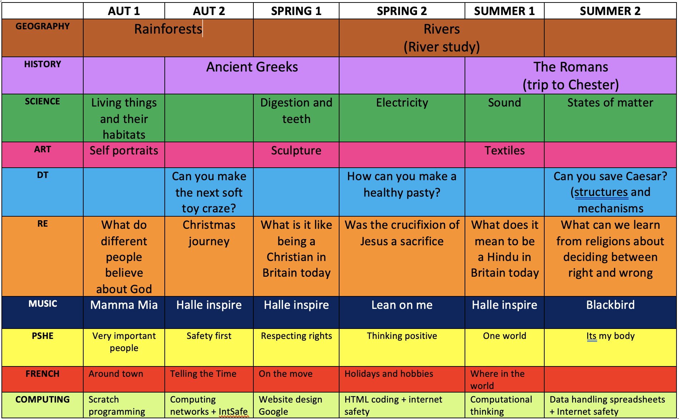

Slide 12
Science
Living things & their Habitats
Digestion & Teeth
Electricity
Sound
States of Matter

Slide 13
History
Geography
Rivers
Rainforests
Ancient Greece
Romans

Slide 14
Art
Portraits
Can you make the next soft toy craze?
How can we make a healthy pasty?
Can you save Cesar? (structures and mechanisms)
Sculptures
Textiles
DT

Slide 15
RE
Why is Jesus inspiring to some people?
What does it mean to be a Hindu in Britain today?
PSHE
Respecting Rights
Thinking Positive
One World
Very Important People
Safety First
What can we learn from religions about deciding what is right and wrong?
Why do some people think life is a journey?
It’s my body

Slide 16
Music
Mama Mia
Hallé
Lean on me
Blackbird
French
Around town
Telling the time
One the move
Holidays and hobbies
Where in the world

Slide 17
Computing
Scratch programmers
Computer networks & internet safety
Website design
HTML coding & internet safety
Computational thinking
Data handing spreadsheets

Slide 18
Trips and visitors:
History
Visit to Chester
Geography
Local area mapping skills
River fieldwork
Manchester Museum

Slide 19
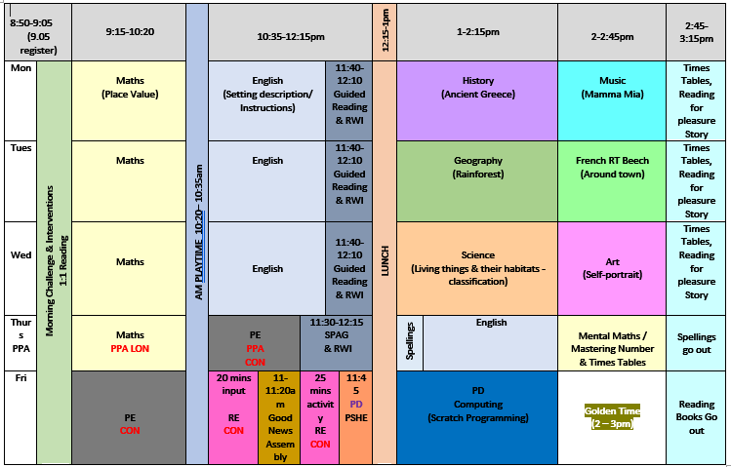
Beech
Timetable
(subject to change)

Slide 20
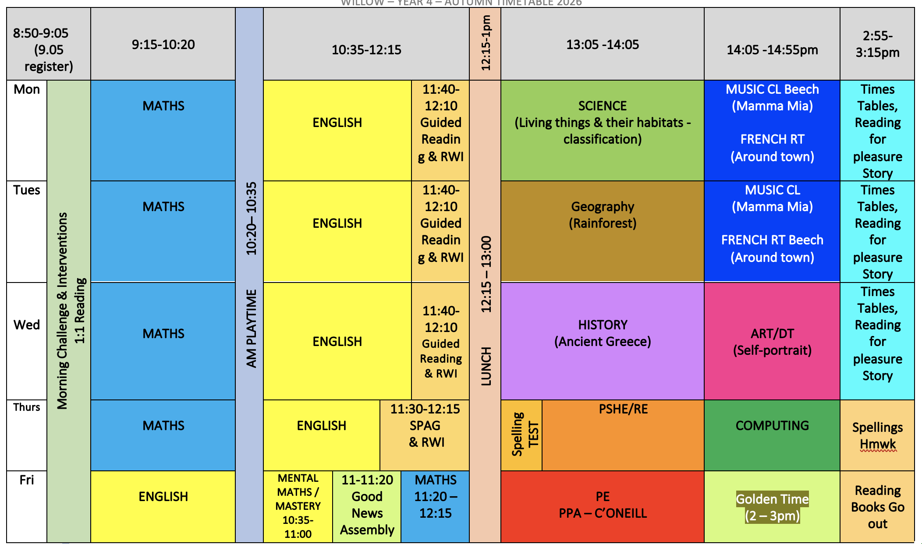
Willow
Timetable
(subject to change)

Slide 21




School values
Class Dojo
Assemblies
Certificates

Slide 22
Website and online communications
Class Dojo
and school story
make sure you have the school Dojo so that you can be kept up to date with information and notices
Gorse Hill Primary School
M32 0pf
0161 865 1209
Please complete the data collection sheets and return as soon as possible.
regularly check the website for up-to-date information.
https://www.gorsehill.trafford.sch.uk/index.asp

Slide 23
Parent meetings
Appointments for meetings can be made via the school office or directly with ourselves.
Direct messaging to class teachers can be done via class dojo or email
It is not usually possible to meet at the start of the day as staff are needed in classrooms.
Send and receive emails send to clangley@gorsehillprimary.co.uk rtahanci@gorsehillprimary.co.uk

Slide 24

Any questions?

